Slide 1

DriverPass
System Analysis
Giddeon Card
Notes:
[No speaker notes required for this slide.]

Slide 2

System Requirements
The system shall utilize two factor authentication for users
The system shall only allow access based on user roles
This system will be web-based
The system will automatically backup frequently
Notes:
The two functional requirements that we are going to talk about are two factor authentication, and role based authorization. Both of these items will make your program more secure, allowing users to know that their data and information is safe. As I’m sure you know, if users trust the systems they use, they will be more likely to use it. More on the non-functional side of things, we will be building this to be a web-based system. This allows the project to reach the widest range of individuals possible, as they will only need a web browser to access it. Additionally, to prevent users from losing their progress, the system will automatically update periodically. This is important in case the system unexpectedly crashes, in which case users could lose all progress.

Slide 3
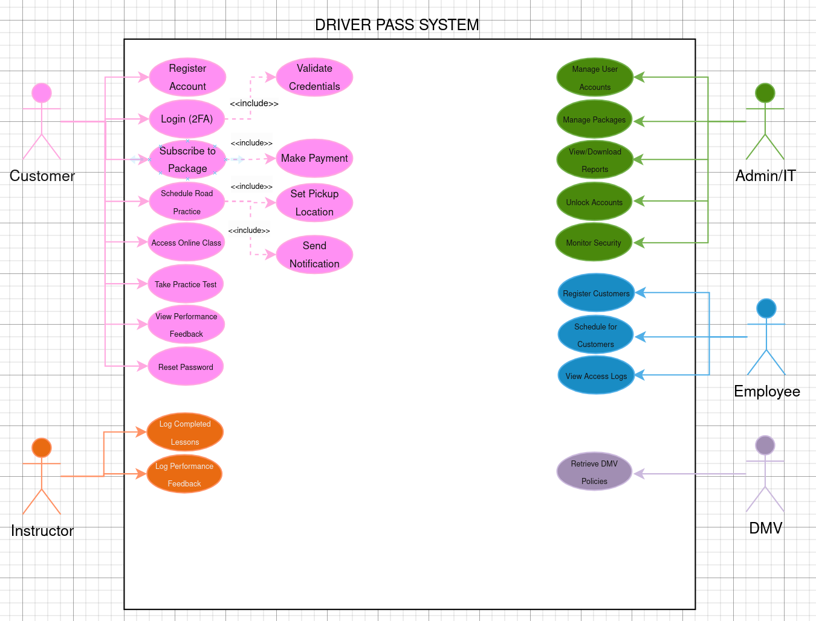
Use Case Diagram
[Insert your use case diagram here.]
Notes:
We expect there to be five different types of individuals accessing this service. The first is the customer, and they will be able to register an account, login with two factor authentication, subscribe to different packages, schedule road practice, access online classes, take practice tests, as well as review their performance feedback and reset passwords. All in all, they will do everything they would want to be able to do to learn how to drive. The next is the instructors, who will be able to log the driving lessons as well as leave performance feedback. Both of these things support quick student learning and success. Next would be employees, who would be able to register customers if necessary as well as schedule drives and look at the system logs to track any potential issues. This ensures that the employees at DriverPass are able to do their job effectively. The next user would be the administrator, who could manage accounts and packages, as well as view reports, unlock accounts, and monitor overall security. This last capability is especially important, as it provides warning if malicious actors are attempting to hack your systems. The last entity to access this system would be the DMV, which is important for retrieving up to date policies and regulations.

Slide 4
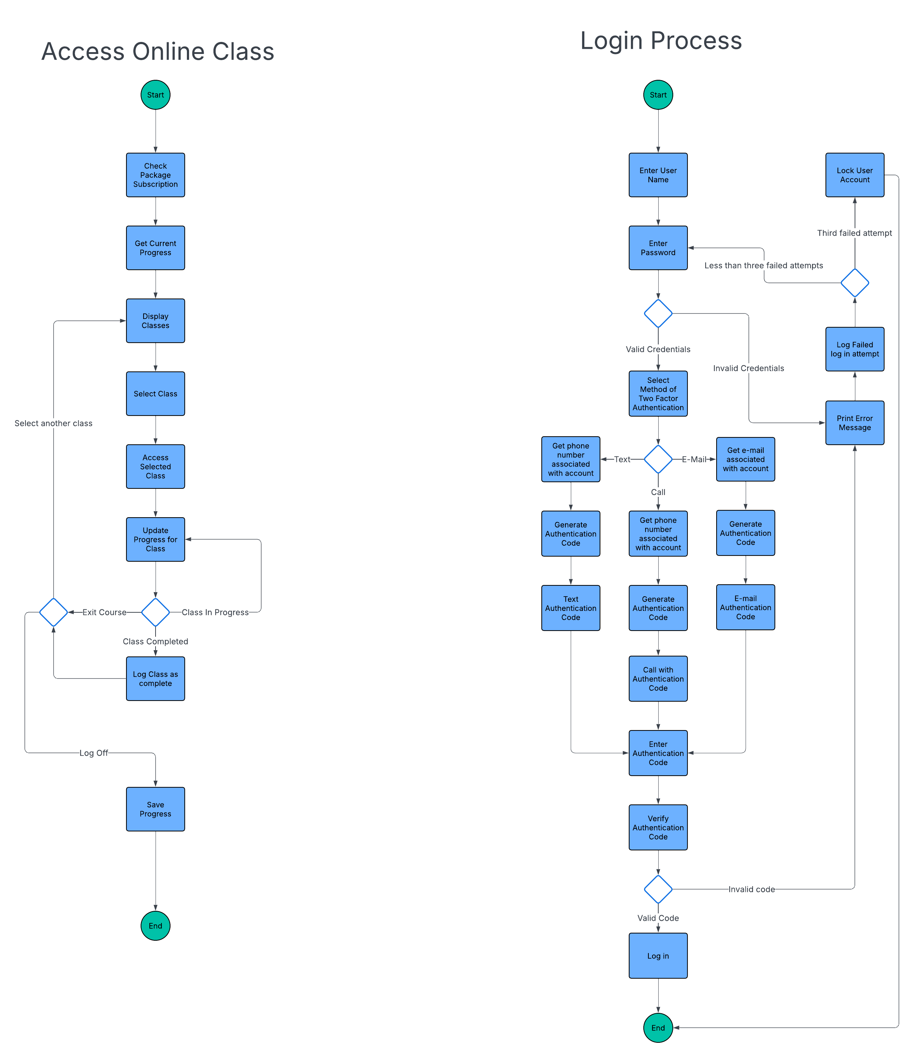
Activity
Diagram
[Insert one of your activity diagrams here.]
Notes:
This diagram demonstrates the process for the secure login into the system. After the user enters his credentials, the system will verify the validity of their information. If the information is valid, the system will provide them with three options for two factor authentication: a text, e-mail, or automated phone call. Depending on their selection, an authentication code will be generated and sent to the customer. The customer is then able to enter the authentication code, and if it is valid, finish the login. Throughout this process, if invalid information is provided they will be returned to the enter password step in the process. If invalid information is entered three times, then the user account will be locked and the administrator will need to unlock it. By having a secure login process, we can ensure that users are protected and malicious attackers are unable to gain access to things like contact and credit card information. Again, when individuals feel that their information is secure, they will be more comfortable using the product at hand.

Slide 5
Security
Two Factor Authentication
HTTPS Protocol
Encrypted Database
Account Locking
Role Based Permissions
Notes:
Security is extremely important and one of the primary things that I consider when designing a system. We are ensuring the system is secure by first using two factor authentication, meaning that malicious agents would require more than just getting someone’s password to gain access to their account. Additionally, we ensure we are connected to the internet via a secure connection with HTTPS protocol. This is another wall that prevents malicious agents from skimming information in transit and potentially gaining sensitive data. By encrypting our database, we also ensure that if agents gain access they will not be able to use any of the information that may be skimmed, as it will all be encrypted and look like a smattering of random numbers and letters. Account locking is also important for security, as it prevents attackers from being able to brute force their way into the system by systematically guessing passwords and authentication codes. Finally, role based permissions ensure that only the people that need access to sensitive information have it. For example, you probably don’t want the customer to be able to access every other customers contact information, so that would be limited to only the administrator.

Slide 6
System Limitations
Interactions with the DMV
Budget
Server capacity
Time
Notes:
Some limitations I expect to face are the system interactions with the DMV. The DMV was not created with user access in mind and I don’t expect it will be possible to completely integrate our systems. Additionally, budget will likely limit the different kind of tools we will be able to use, as the better the tool the more expensive it may be. The server load may also be a concern depending on the number of users we expect to get. If there are too many, it may overload the server and crash the website. This can be resolved by using more servers, but again, the budget would likely restrict our operations there. The final restriction would be time. If we had all the time in the world, we could create a perfect system that doesn’t just perform its primary function, but does even more than that. Unfortunately we don’t have unlimited time, so while we will deliver this product to you on time, that will provide some limitations for us.

